Slide 1

Reinforcement Learning
Naeemullah Khan
naeemullah.khan@kaust.edu.sa
KAUST Academy
King Abdullah University of Science and Technology

Slide 2
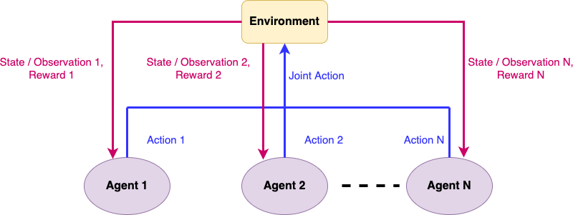
Multi-agent Reinforcement Learning
Multi-agent Games + Sequential decision making
Newer field with unique challenges and opportunities

Slide 3

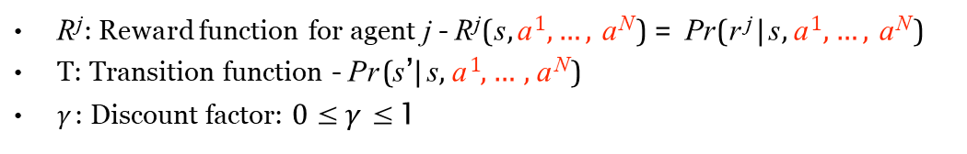
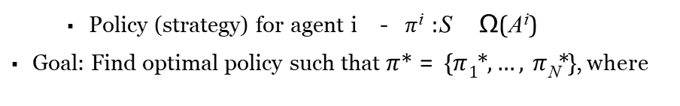
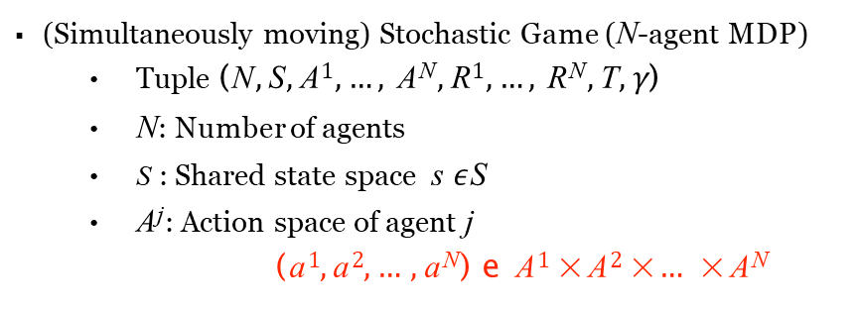
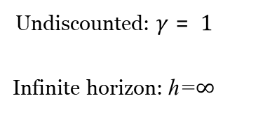
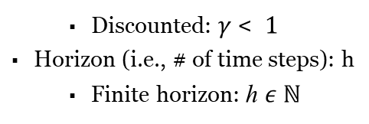
Stochastic Games
(Simultaneously moving) Stochastic Game (N-agent MDP)
Tuple (N, S, A¹, …, A^{N}, R¹, …, R^{N}, T, $γ$)
N: Number of agents
S : Shared state space s $ε$S
A^{j}: Action space of agent j
(a¹, a², …, a^{N}) e A¹ × A² × … × A^{N}
R^{j}: Reward function for agent j - R^{j}(s, a¹, …, a^{N} ) = Pr(r ^{j} | s, a¹, …, a^{N} )
T: Transition function - Pr(s’| s, a¹, …, a^{N} )
$γ$: Discount factor: 0 ≤ $γ$ ≤ 1
Unknown Models
Discounted: $γ$ < 1
Horizon (i.e., # of time steps): h
Finite horizon: h $ε ℕ$
Undiscounted: $γ$ = 1
Infinite horizon: h=$∞$
Policy (strategy) for agent i - $π$^{i} :S Ω(A^{i})
Goal: Find optimal policy such that $π$* = {$π$₁*, …, $π$_{N}*}, where

Slide 4
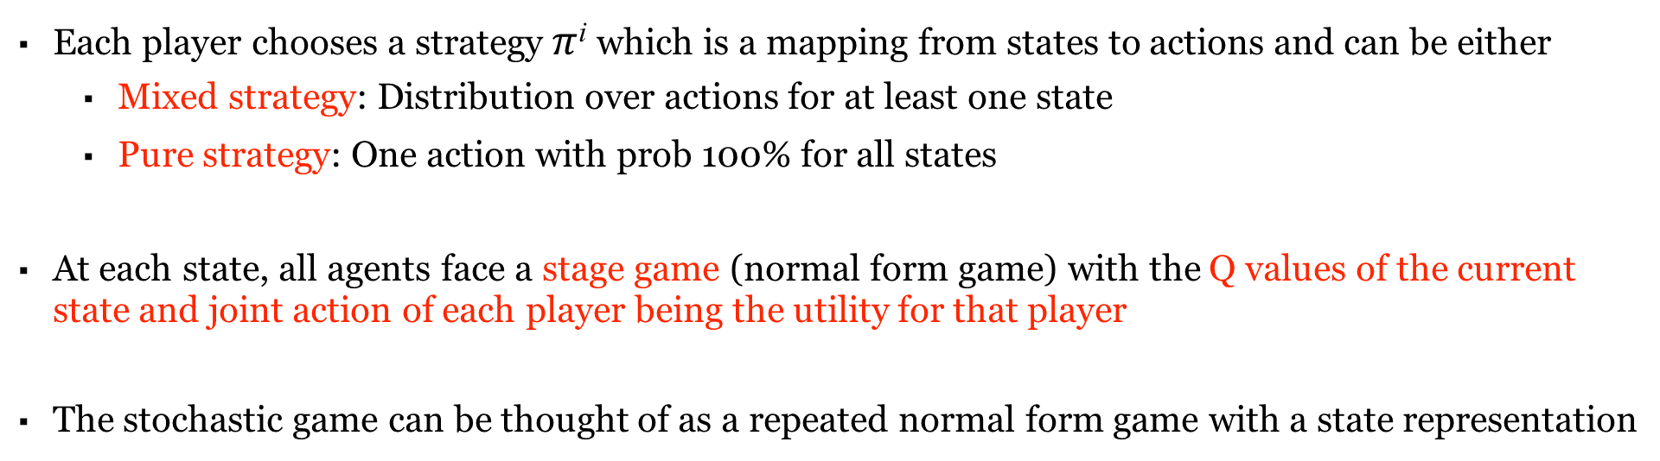
Playing a stochastic game
Players choose their actions at the same time
No communication with other agents
No observation of other player’s actions
Each player chooses a strategy $π$^{i} which is a mapping from states to actions and can be either
Mixed strategy: Distribution over actions for at least one state
Pure strategy: One action with prob 100% for all states
At each state, all agents face a stage game (normal form game) with the Q values of the current state and joint action of each player being the utility for that player
The stochastic game can be thought of as a repeated normal form game with a state representation

Slide 5
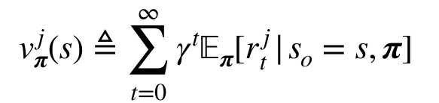
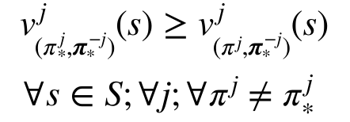
Optimal Policy
In MARL, the optimal policy should correspond to some equilibrium of the stochastic game
The most common solution concept is the Nash equilibrium
Let us define a value function for the multi-agent setting
Nash equilibrium under the stochastic game satisfies

Slide 6
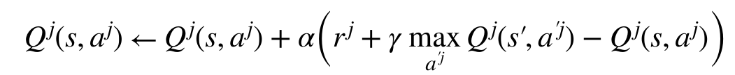
Independent learning
Naive approach: Apply the single agent Q-learning directly
Each agent would update its Q-values using the Bellman update:
Each agent assumes that the other agent(s) are part of the environment
Merit: Simple approach, easy to apply
Demerit: Might not work well against opponents playing complex strategies
Demerit: Non-stationary transition and reward models
Demerit: No convergence guarantees

Slide 7
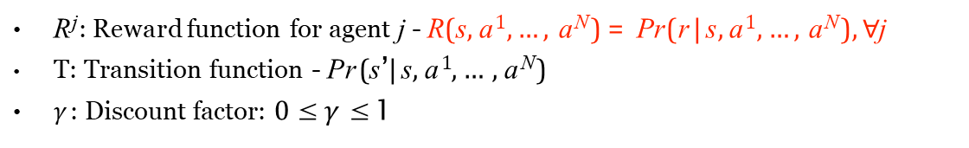
Cooperative Stochastic Games
(Simultaneously moving) Stochastic Game (N-agent MDP)
Tuple (N, S, A¹, …, A^{N}, R¹, …, R^{N}, T, $γ$)
N: Number of agents
S : Shared state space s $ε$S
A^{j}: Action space of agent j
(a¹, a², …, a^{N}) e A¹ × A² × … × A^{N}
R^{j}: Reward function for agent j - R(s, a¹, …, a^{N} ) = Pr(r | s, a¹, …, a^{N} ), $∀$j
T: Transition function - Pr(s’| s, a¹, …, a^{N} )
$γ$: Discount factor: 0 ≤ $γ$ ≤ 1
Unknown Models
Discounted: $γ$ < 1
Horizon (i.e., # of time steps): h
Finite horizon: h $ε ℕ$
Undiscounted: $γ$ = 1
Infinite horizon: h=$∞$
Policy (strategy) for agent i - $π$^{i} :S Ω(A^{i})
Goal: Find optimal policy such that $π$* = {$π$₁*, …, $π$_{N}*}, where

Slide 8
Optimal Policy
The equilibrium in the case of cooperative stochastic games is the Pareto dominating (Nash) equilibrium
Each stage game of this stochastic game faces a coordination game
There exists a unique Pareto dominating (Nash) equilibrium in utilities
Bob
Baseball
Soccer
2,2 | 0,0
0,0 | 1,1
Baseball
Alice
Soccer

Slide 9
Opponent Modelling
Note that an agent’s response requires knowledge of other agent’s actions
This is a simultaneously move game where each agent does not know what the other agents will do
So each agent should maintain a belief over other agents actions at current state
This process of maintaining and updating a belief over the next actions of other agents is called opponent modelling
Types of Opponent Modelling:
Fictitious Play
Gradient Based Methods
Solving Unique Equilibrium (for each stage game)
Bayesian Approaches

Slide 10
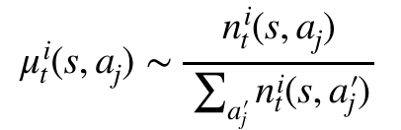
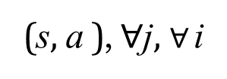
Fictitious Play
Each agent assumes that all opponents are playing a stationary mixed strategy
Agents maintain a count of number of times another agent performs an action
n^{i}(s, a ) 1 + n^{i}
(s, a ), $∀$j, $∀$i
t j
t−1
j
Agents update and sample an action from their belief about this strategy at each state according to
The fictitious action µ^{i}(s, a ) is sampled from an empirical distribution of past actions of other
t j
agent (mixed strategy)
Agents calculate best responses according to this belief

Slide 11
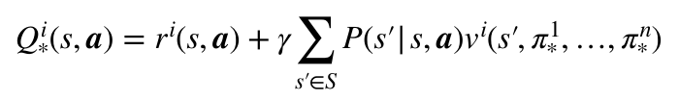
Learning in cooperative stochastic games
Algorithm: Joint action learner (JAL) or Joint Q learning (JQL)
Challenge: Respond to environment as well as opponent(s)
Same as Q learning but agents also include the opponent action in Q-updates
Each agent would update its Q-values using the Bellman update:
Need to balance exploration exploitation tradeoff
Objective for agent: Find the optimal policy for best response
Objective for system: Find the NE of the stochastic game (or Nash Q function for the game)
Nash Q function: Agent’s immediate reward and discounted future rewards when all agents follow the NE policy

Slide 12
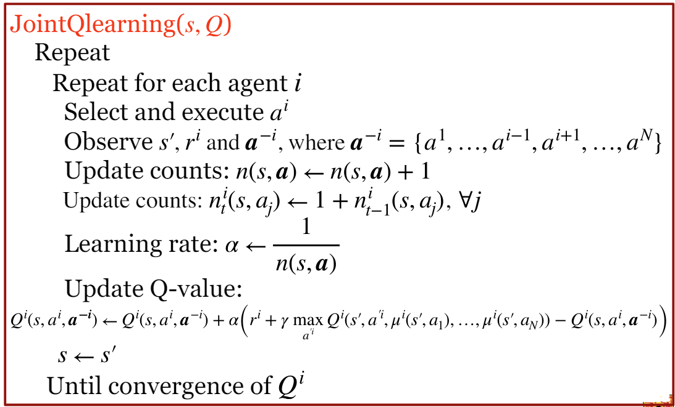
Joint Q learning

Slide 13
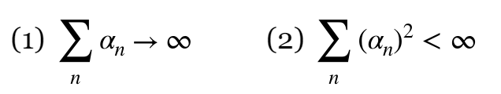
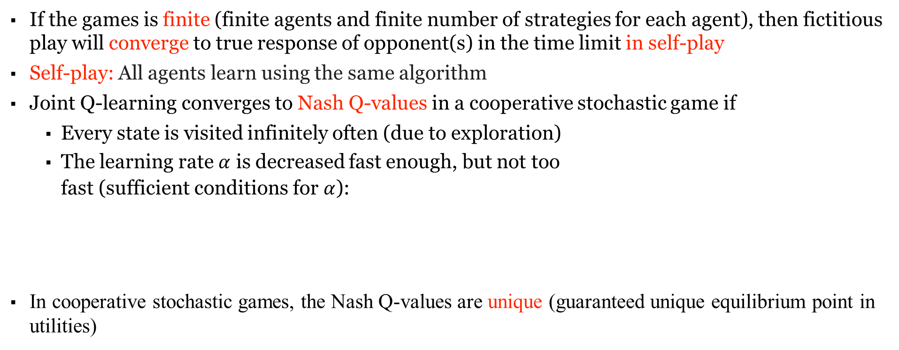
Convergence of joint Q learning
If the games is finite (finite agents and finite number of strategies for each agent), then fictitious play will converge to true response of opponent(s) in the time limit in self-play
Self-play: All agents learn using the same algorithm
Joint Q-learning converges to Nash Q-values in a cooperative stochastic game if
Every state is visited infinitely often (due to exploration)
The learning rate $α$ is decreased fast enough, but not too fast (sufficient conditions for $α$):
In cooperative stochastic games, the Nash Q-values are unique (guaranteed unique equilibrium point in utilities)

Slide 14
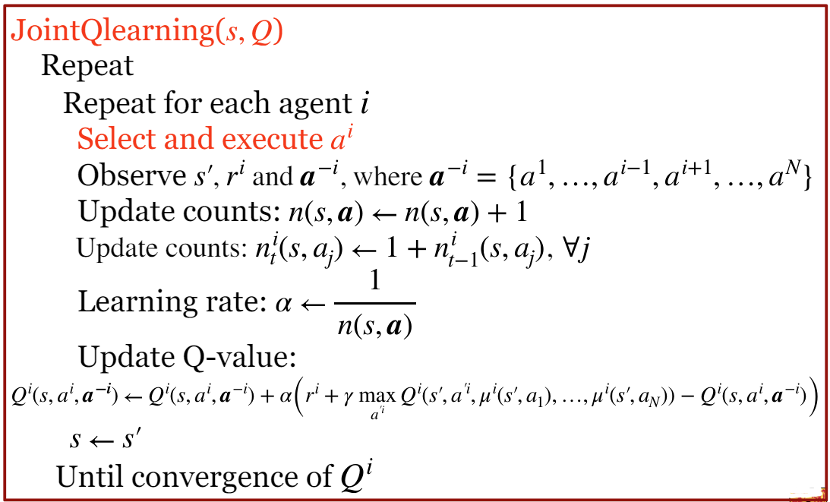
Joint Q learning

Slide 15
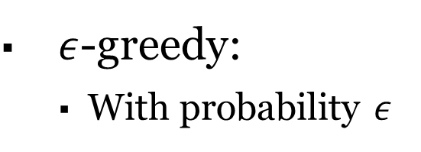
Common exploration methods
$ε$-greedy:
With probability $ε$
, execute random action
Otherwise execute best action a_{i}* = arg max Q^{i}(s, a^{i}, µ^{i}(s, a₁), …, µ^{i}(s, a_{N}))
_{a}i
Boltzmann exploration
Increasing temperature T increases stochasticity
e
Q^{i}(s, a^{i}, µ^{i}(s, a₁), …, µ^{i}(s, a_{N} ))
Pr(a) =
T
▪
Σ_{a} e
Q^{i}(s, a^{i}, µ^{i}(s, a₁), …, µ^{i}(s, a_{N} ))
T

Slide 16

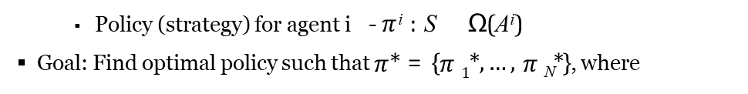
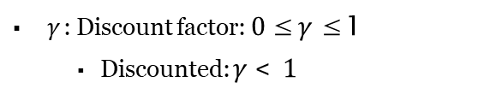
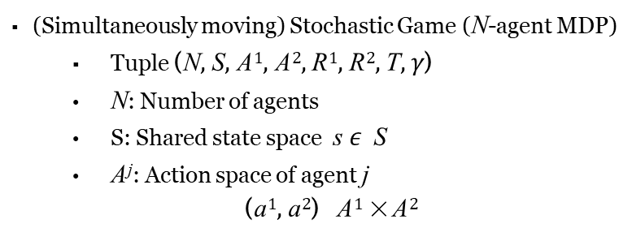

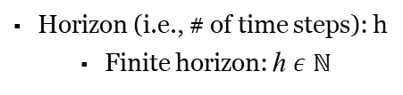
Competitive Stochastic Games
(Simultaneously moving) Stochastic Game (N-agent MDP)
Tuple (N, S, A¹, A², R¹, R², T, $γ$)
N: Number of agents
S: Shared state space s $ε$ S
A^{j}: Action space of agent j
(a¹, a²) A¹ × A²
R^{j}: Reward function for agent j - R^{j}(s, a¹, a²) = Pr (r ^{j} | s , a¹, a²), $∀$j
t t t t
Unknown Models
1 2
Condition on Reward function: r_{t} + r_{t} = 0, $∀$t
T : Transition function - Pr (s’| s, a¹, a²)
$γ$: Discount factor: 0 ≤ $γ$ ≤ 1
Discounted: $γ$ < 1
Undiscounted: $γ$ = 1
Infinite horizon: h=$∞$
Horizon (i.e., # of time steps): h
Finite horizon: h $ε ℕ$
Policy (strategy) for agent i - $π$^{i} : S Ω(A^{i})
Goal: Find optimal policy such that $π$* = {$π$₁*, …, $π$_{N}*}, where
i

Slide 17
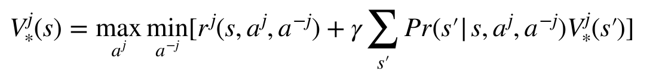
Optimal Policy
The equilibrium in the case of competitive stochastic games is the min-max Nash equilibrium
Each stage game of this stochastic game faces a zero-sum game
There exists a unique min-max (Nash) equilibrium in utilities
Optimal min-max value function
For a competitive stochastic game there exists a unique min-max value function and hence a unique min-max Q-function

Slide 18
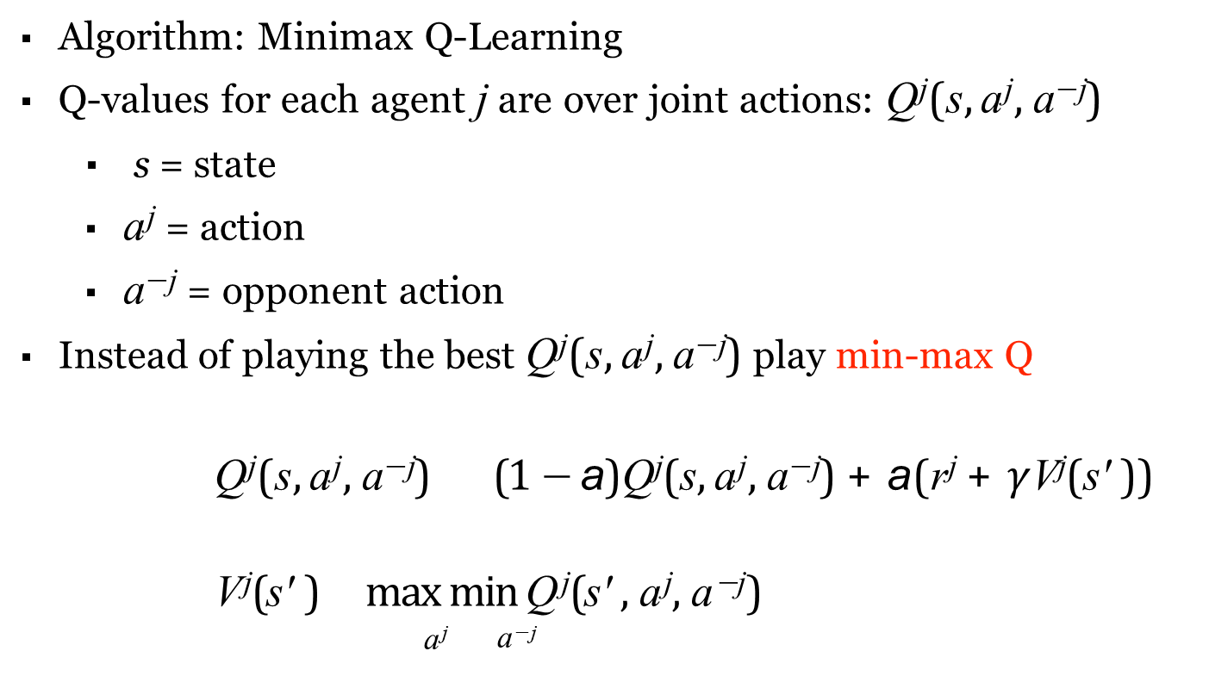
Learning in competitive stochastic games
Algorithm: Minimax Q-Learning
Q-values for each agent j are over joint actions: Q^{j}(s, a^{j}, a^{−j})
▪ s = state
a^{j} = action
a^{−j} = opponent action
Instead of playing the best Q^{j}(s, a^{j}, a^{−j}) play min-max Q
Q^{j}(s, a^{j}, a^{−j}) (1 − a)Q^{j}(s, a^{j}, a^{−j}) + a(r^{j} + $γ$V^{j}(s' ))
V^{j}(s' ) max min Q^{j}(s' , a^{j}, a^{−j})
_{a}j _{a}−j

Slide 19
Minimax Q learning
Minimax Qlearning(s, a, Q*) Repeat
Repeat for each agent
Select and execute action a^{j} Observe s' , a^{−j} and
Update counts: n(s, a) ₁ n(s, a) +
Learning rate: a
n(s, a)
Update Q-value:
Q^{j}(s, a^{j}, a^{−j}) (1 − a)Q^{j}(s, a^{j}, a^{−j}) + a(r^{j} + $γ$ max min Q^{j}(s’, a^{’j}, a^{’−j})))
* *
_{a}’j _{a}’−j
*
s s'
Until convergence of Q*
Return Q*

Slide 20
Opponent Modelling
In a competitive game rational agents always take a min-max action
There is no requirement for a separate opponent modelling strategy in self-play
However:
Other agents could use different algorithms
Computing the min-max action can be time consuming
Alternative: Fictitious play
Theorem: Fictitious play also converges in competitive zero-sum games
Theorem: Fictitious play converges to the min-max action in self-play

Slide 21
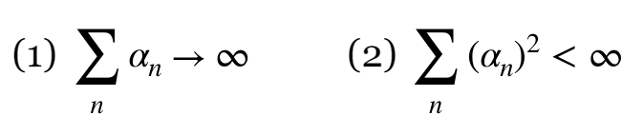
Convergence of Minimax Q learning
Convergence in self-play
Minimax Q-learning converges to min-max equilibrium in a competitive stochastic game if:
Every state is visited infinitely often (due to exploration)
The learning rate is decreased fast enough, but not too fast (sufficient conditions for ):
In a competitive stochastic games, the Nash Q-values are unique (guaranteed unique min-max equilibrium point in utilities)

Slide 22
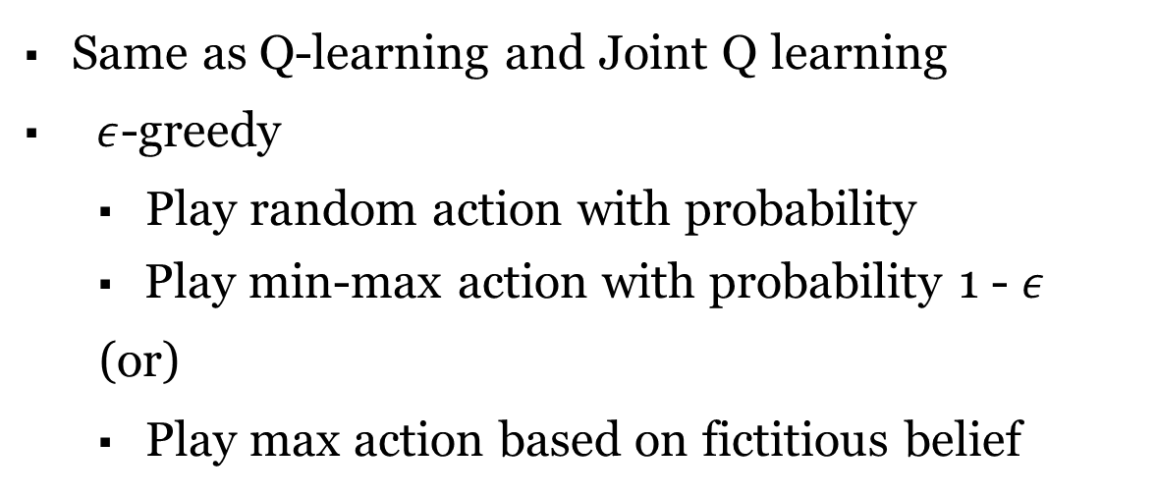
Exploration vs Exploitation Tradeoff
Same as Q-learning and Joint Q learning
$ε$-greedy
Play random action with probability
Play min-max action with probability 1 - $ε$
(or)
Play max action based on fictitious belief

Slide 23
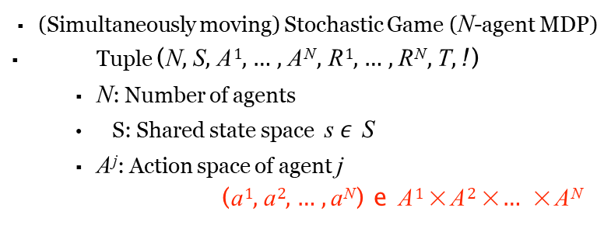
(Mixed) Stochastic Games/ General-sum Stochastic Game
(Simultaneously moving) Stochastic Game (N-agent MDP)
Tuple (N, S, A¹, …, A^{N}, R¹, …, R^{N}, T, !)
N: Number of agents
S: Shared state space s $ε$ S
A^{j}: Action space of agent j
(a¹, a², …, a^{N}) e A¹ × A² × … × A^{N}
R^{j}: Reward function for agent j - R^{j}(s, a¹, …, a^{N} ) = Pr (r ^{j} | s, a¹, …, a^{N} )
Rewards of all agents can be related arbitrarily
T: Transition function - Pr (s’| s, a¹, …, a^{N} )
Unknown Models
$γ$: Discount factor: 0 ≤ $γ$ ≤ 1
Discounted: $γ$ < 1
Undiscounted: $γ$ = 1
Infinite horizon: h=$∞$
Horizon (i.e., # of time steps): h
Finite horizon: h $ε ℕ$
Policy (strategy) for agent i - $π$^{i} : S Ω(A^{i})
Goal: Find optimal policy such that $π$* = {$π$₁*, …, $π$_{N}*}, where

Slide 24
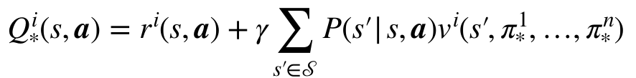
Optimal Policy
The equilibrium in the case of competitive stochastic games is the (mixed strategy) Nash equilibrium for the stochastic game
Nash theorem guarantees at-least one mixed strategy NE exists
There could be multiple Nash equilibria
Objective for agent: Find the optimal policy for best response
Objective for system: Find the NE of the stochastic game (or Nash Q function for the game)
Nash Q function: Agent’s immediate reward and discounted future rewards when all agents follow the NE policy
Problem: Which NE should we converge to?

Slide 25
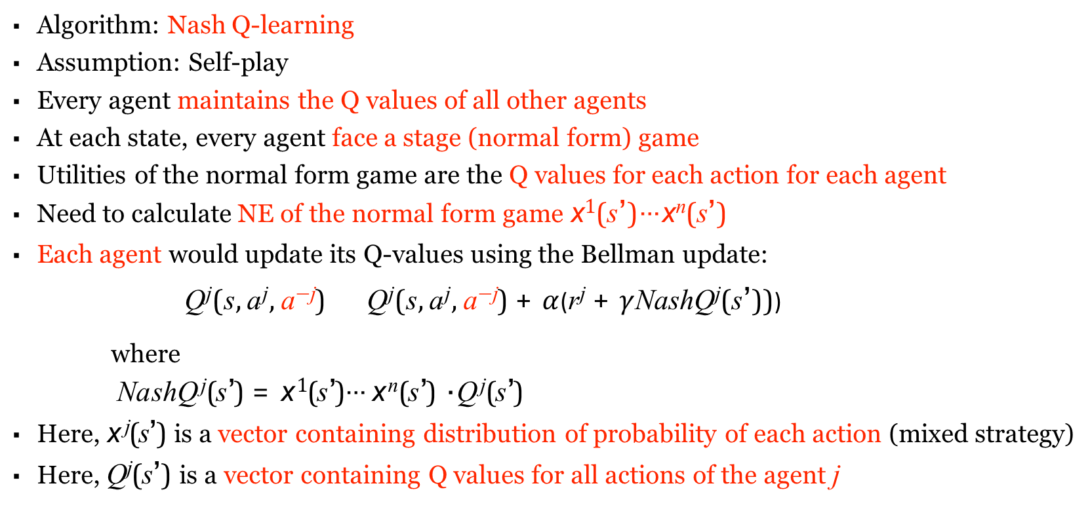
Learning in General-sum stochastic games
Algorithm: Nash Q-learning
Assumption: Self-play
Every agent maintains the Q values of all other agents
At each state, every agent face a stage (normal form) game
Utilities of the normal form game are the Q values for each action for each agent
Need to calculate NE of the normal form game x¹(s’)⋯x^{n}(s’)
Each agent would update its Q-values using the Bellman update:
Q^{j}(s, a^{j}, a^{−j}) Q^{j}(s, a^{j}, a^{−j}) + $α$(r^{j} + $γ$NashQ^{j}(s’)))
where
NashQ^{j}(s’) = x¹(s’)⋯x^{n}(s’) · Q^{j}(s’)
Here, x ^{j}(s’) is a vector containing distribution of probability of each action (mixed strategy)
Here, Q^{j}(s’) is a vector containing Q values for all actions of the agent j

Slide 26
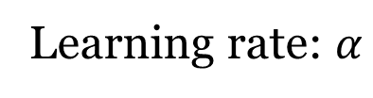
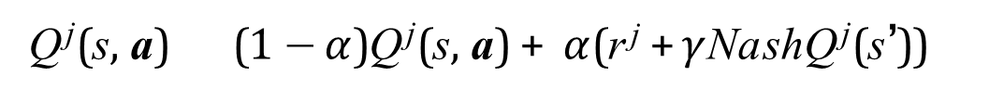
Nash Q learning
NashQ learning(s, a, Q*) Repeat
Repeat for each agent
Select and execute action a^{j} Observe s’, a^{−j} and r + r¹, …, r^{N}
Update counts: n(s, a) n(s, a) +1
Learning rate: $α$
1
n(s, a)
Update Q-value for every j = 1,…, n:
Q^{j}(s, a) (1 − $α$)Q^{j}(s, a) + $α$(r^{j} +$γ$NashQ^{j}(s’))
* * *
s s'
Until convergence of Q*
Return Q*

Slide 27
Opponent Modelling
Note: Each agent is maintaining Q-values of all agents
Solution 1: Agents can take equilibrium action if unique
Problem: Non-unique equilibria in practice
Problem: Equilibrium computation can take a long time
Problem: Convergence only under strong assumptions (unique equilibrium)
Solution 2: Fictitious play
Problem:Convergence only under strong assumptions (unique equilibrium)
Solution 3: Assume every agent is playing independent learning
Problem: No convergence guarantees

Slide 28
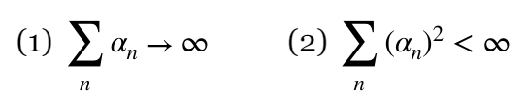
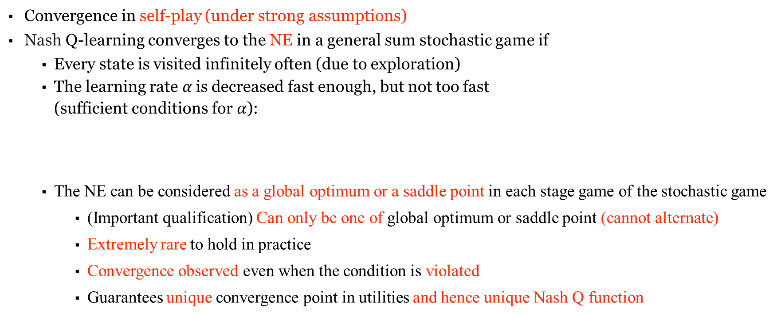
Convergence of Nash Q-learning
Convergence in self-play (under strong assumptions)
Nash Q-learning converges to the NE in a general sum stochastic game if
Every state is visited infinitely often (due to exploration)
The learning rate $α$is decreased fast enough, but not too fast (sufficient conditions for $α$):
The NE can be considered as a global optimum or a saddle point in each stage game of the stochastic game
(Important qualification) Can only be one of global optimum or saddle point (cannot alternate)
Extremely rare to hold in practice
Convergence observed even when the condition is violated
Guarantees unique convergence point in utilities and hence unique Nash Q function

Slide 29
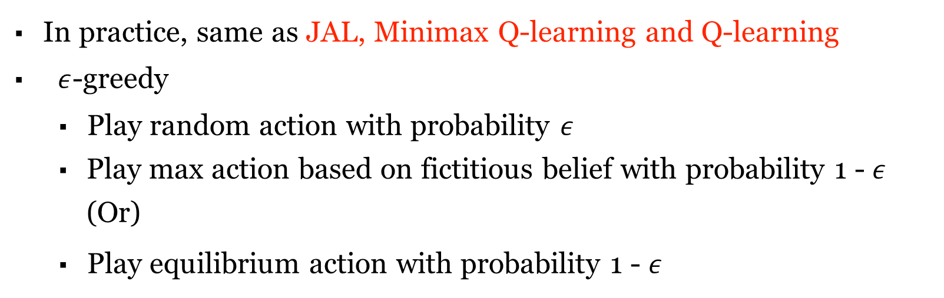
Exploration vs Exploitation Tradeoff
In practice, same as JAL, Minimax Q-learning and Q-learning
$ε$-greedy
Play random action with probability $ε$
Play max action based on fictitious belief with probability 1 - $ε$ (Or)
Play equilibrium action with probability 1 - $ε$

Slide 30
Alternative approaches
A NE is not always the best solution
NE is attractive because it is unrestrictive (all agents can be independent) and Nash theorem guarantees existence
Can consider other equilibria as well:
Pareto-optimality
Regret
Correlated equilibrium
Dominant strategy equilibrium
Function approximation techniques
Model-based techniques

Slide 31
References
These slides have been adapted from
Pascal Poupart & Sriram Ganapathi Subramanian, CS486: Introduction to Artificial Intelligence, University of Waterloo

